Slide 1
IGGI Game Design Part II AI Informed Game Design
Simon Lucas and Diego Perez

Slide 2
AI Informed Game Design
How can AI be used to make better games?
What does better mean?
Set design objectives in terms of player experience
Then try to meet them
Measure experience of a range of AI bots
Also run user trials
The course will be taught with a mixture of lectures, labs (including game AI competitions), group work
There are also seminars which should be attended (see schedule)

Slide 3
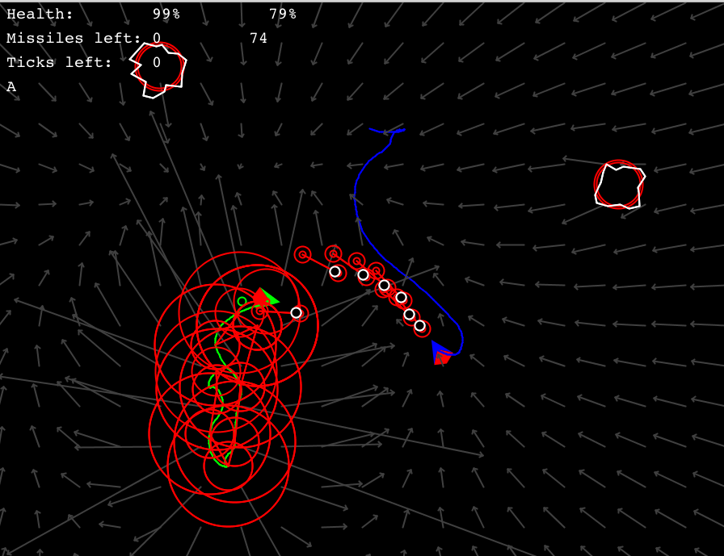
Example from 2015: “Battle Asteroids” (Thanks to IGGI Student: Memo Akten, Daniel Berio, Piers Williams, Joseph Walton-Rivers)
MCTS able to create reasonable agents for 2-player game
Sometimes with the silly assumptions about what the opponent will do!
Notes:
Example shows a mashup game taking Asteroids ships physics and rock-shooting, combined with snake or Tron style trail, and 2-player battle mode.

Slide 4
Main Topics
Game Design Spaces
Design, Implementation and Testing
Player Experience
And how to measure it
General Video Game AI and Video Game Description Language (VGDL)
General and easily applied AI Agent Algorithms
Mini AI Competitions
Game Mashups

Slide 5
Automated Game Design
An exciting topic in Game AI and in Computational Creativity
Can an algorithm automatically design novel high quality games, or game levels?
Or perhaps choose good parameters for an existing game?
Work in this area has been around for a while
But with better general purpose AI, is really starting to take off now!

Slide 6
Automated Game Design: Main Steps and Challenges
Main steps:
Creating a search space for a set of games (or game levels)
Creating operators to choose points in the space, and also variation operators to choose points in some neighbourhood (e.g. a Mutation operator)
Evaluate points in the search space
In general, the final step (evaluation) is the hardest!
For a restricted set of games, we can write evaluation heuristics
Or measure the experience of AI bots …

Slide 7
Using AI Bots for Play-Testing
Two challenges with the AI bots:
Providing bots which are smart enough (remember it’s easy to make a smart bot behave stupidly)
General Video Game AI (GVGAI) has already made good progress with this
But plenty more is possible
Interpreting the experience the bots have in a meaningful way.
Hard in general, but some notable successes

Slide 8
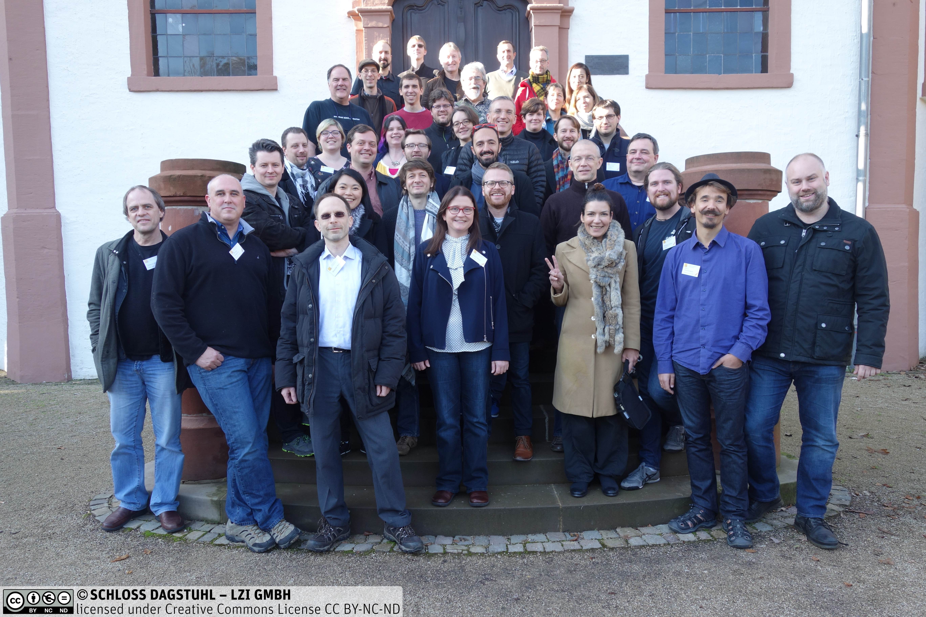
We’ll run it a bit like a Dagstuhl Seminar – Interesting challenges solved in groups

Slide 9
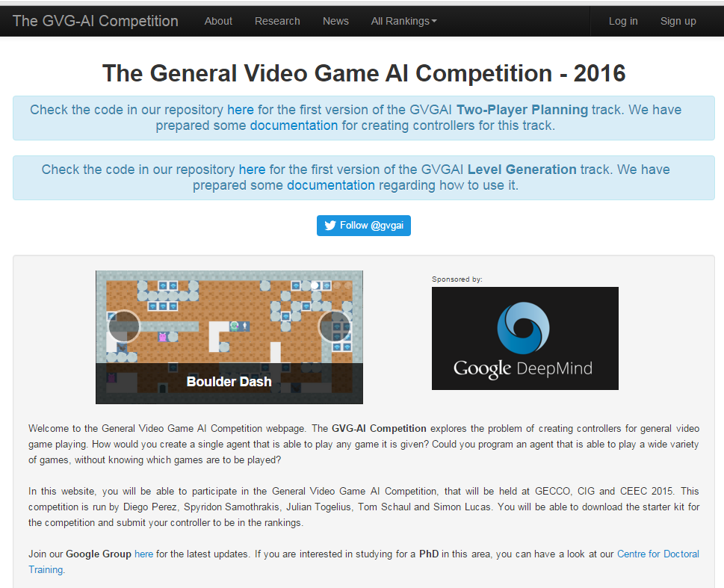
Can we find a sweet spot search space between numerical parameter tuning and VGDL?

Slide 10
Deliverables / Assessments
Report in the form of a short draft conference paper. The paper should include or be accompanied by a brief statement of the contribution of each author.
Peer-review comments on the paper (peer review is by course participants)
Code for two versions of a game drawn from a game design space
A video showing the games in action
Results of user trials, if any
Data (game logs etc) underlying the results in the paper
We encourage groups to revise their papers after the peer feedback and submit to a relevant conference or workshop

Slide 11
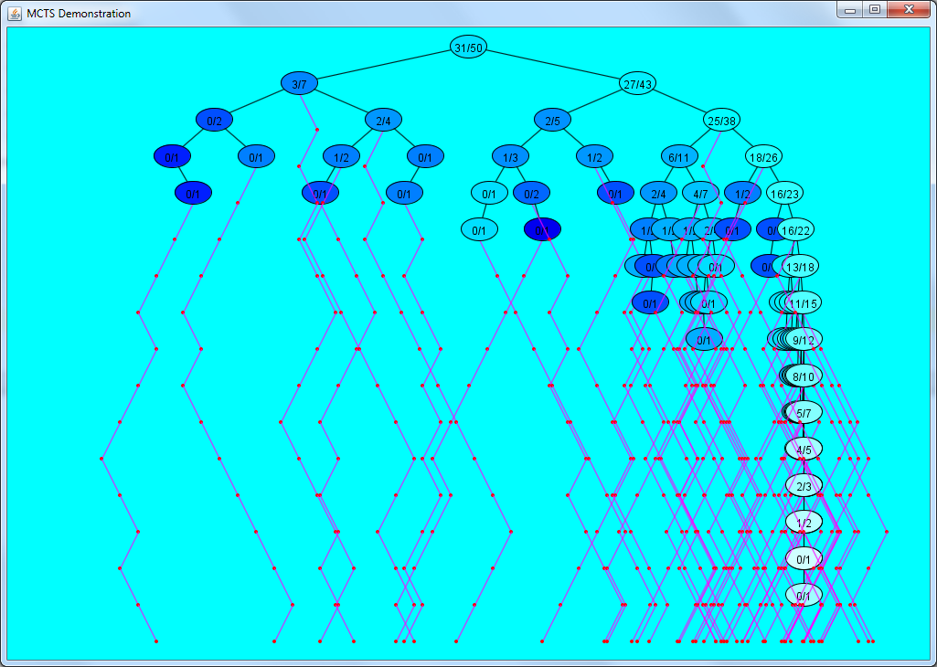
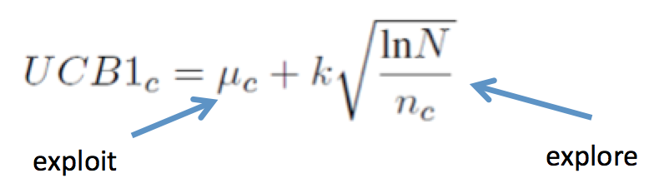
A Taste of Things to Come (MCTS)
Aims to balance exploration and exploitation
In video games the limited roll-out budget is a challenge, but not the only one!
Notes:
MCTS build asymmetric trees – balancing exploration and exploitation. Interestingly the exploration constant is often set to zero, with other heuristic terms being used to force exploration

Slide 12
AI Agent Algorithms
Simulation-based (require a forward model, preferably a fast one!)
Flat Monte Carlo (MC)
Monte Carlo Tree Search (MCTS)
Rolling Horizon Evolutionary Algorithms
Reactive (no forward model, or limited forward model)
Neural nets and other function approximators
Table-based
Trained through Evolution or Temporal Difference Learning
These methods can also be very effectively hybridised for best performance
Good deal of skill (and very interesting exercise) in designing features for neural nets)

Slide 13
Simulation-based versus Learning Based AI
Simulation-based AI:
Intelligence emerges by running lots of simulations
Can work with NO prior training
Though training can be used to improve performance
Instant intelligence, but can be CPU hungry
Learning-based AI
May much faster than simulation-based AI once trained
BUT: may take a LONG time to train (hours, days or even longer)

Slide 14
Applications of Adaptive Game AI
Instant high quality opponents and / or collaborators
No programming of the agent needed – just ensure that the game implements a standard interface
Automated play testing of games
Can invent new games easily!
Picking the good ones is the trickier part…
Adaptive AI can help
Measure drama
Measure skill
Can “good” players beat random players
What is span of Elo ratings?
A large span is evidence that the game has skill depth

Slide 15
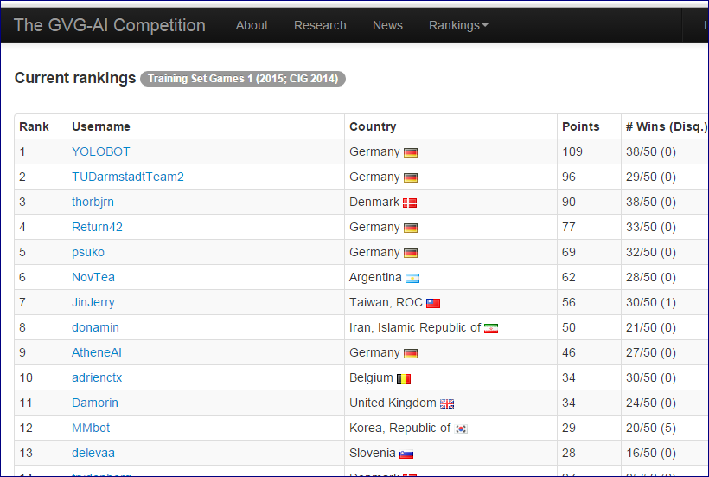
Should good games have a large span of game agent rankings?

Slide 16
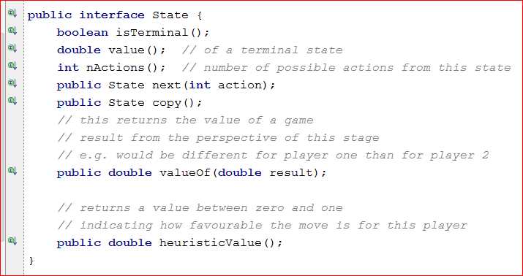
Making your game amenable to simulation-based AI: Implement State interface (details may vary a bit – this shows the main idea; method names may change e.g. next is sometimes called advance or update)
Notes:
Here we’re looking at the most common form of the algorithm with a discrete action space

Slide 17
Evaluating Games using AI Bots
More of this will be covered in the Player Experience Modelling slides
But note that many aspects of a game can be measured using bots
For many of these it is not necessary that a bot mimics a human player
Though that would be ideal!
And keep in mind there is enormous variation in the set of human players
So what it means to be “human-like” is not precisely defined

Slide 18
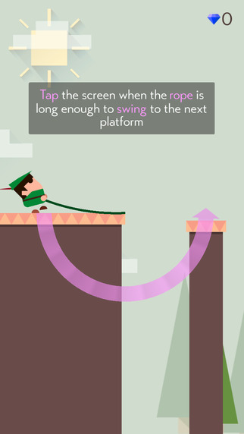
One-Touch Casual Games
Flappy Bird Phenomenon
Since then some good one-touch games
Retry, Mr Jump, Swing

Slide 19
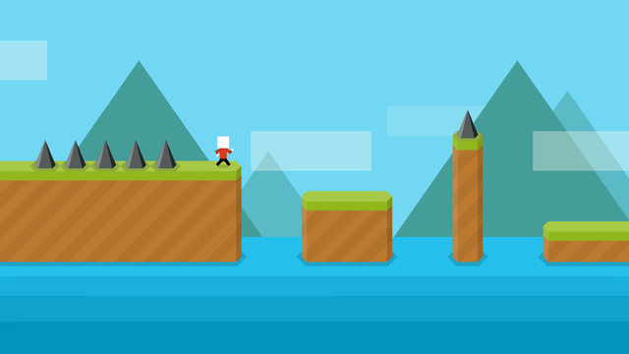
Mr Jump

Slide 20
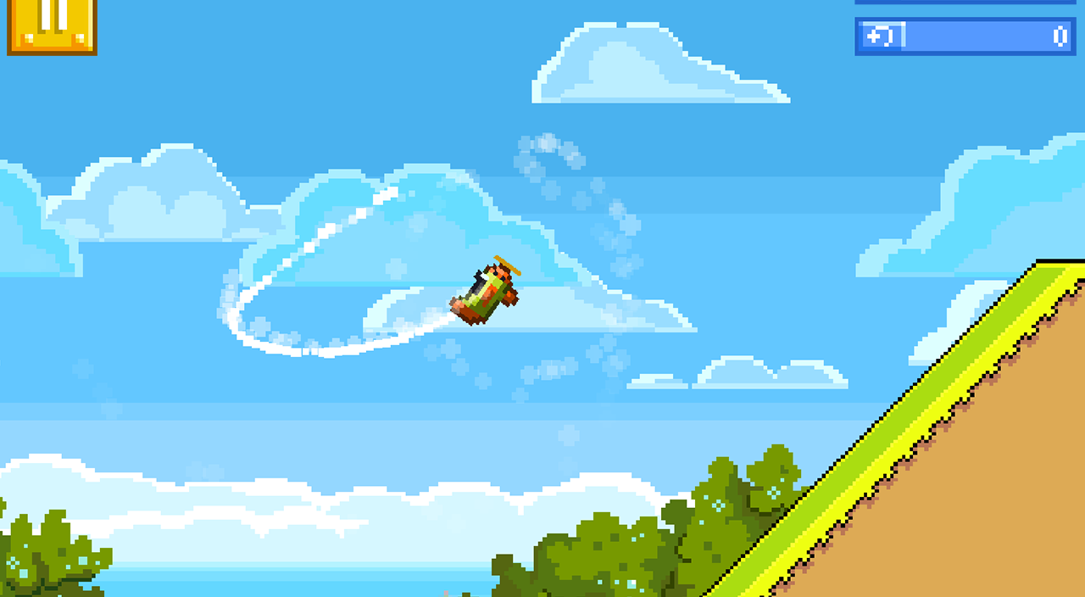
Retry

Slide 21
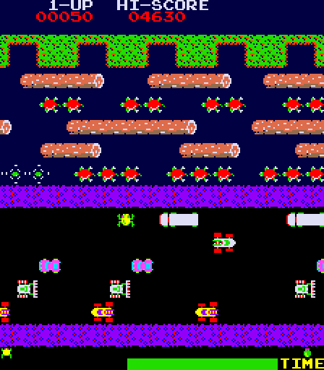
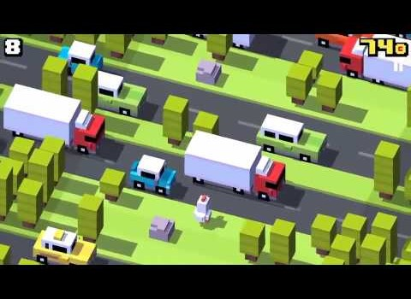
Plenty of “inspiration” out there…
Notes:
So many classic arcade games: interesting opportunities to breathe new life into them!

Slide 22
Observation
There are great opportunities for mining minor variations in existing games
Tuning the hell out of a format

Slide 23
Ambitious Searchable Design Spaces
Togelius and Schmidhuber (CIG 2008)
Cook and Colton (CIG 2011, …)
The above were ambitious in the open-ended nature of the rules – but the games had limited variations in the physics
Even more open-ended:
Video Game Description Language
Ebner at al Dagstuhl 2012, Schaul CIG 2013)
All interesting work
Difficult to auto-generate good quality human-playable games

Slide 24
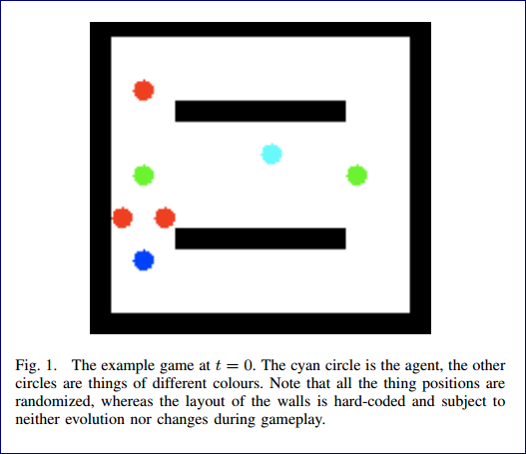
Togelius and Schmidhuber
Three items:
Set of numerical parameters
Table of collision effects
Table of collision scores
Evaluation was complex: how well could agents learn to play a game?
Inspiring work, but results were restricted by the cost of each fitness evaluation, and the learning ability of the algorithms
Current approach would more likely be MCTS-based

Slide 25
The Devil is in the Detail
The big picture is important as well, BUT:
Tuning the details has a massive effect on playability of a game
We can separate out the identifying and setting of the detailed parameters
From measuring the effects of particular combinations of settings
The details can be hand tuned or automatically tuned
How can we measure the quality of a game?
Human play testing
Measuring experience of AI bots

Slide 26
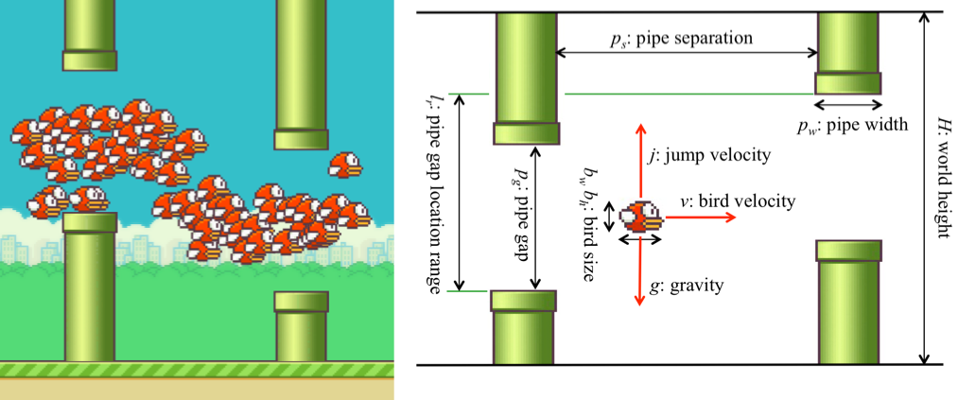
Searching a Flappy Bird Design Space (work by Aaron Isaksen et al @ NYU)
Interesting approach:
Identify a number of numerical parameters
Search for combinations of parameters that lead to playable games

Slide 27
What is a playable Flappy Bird game?
A simple but near optimal AI player is used with a small amount of random noise
The noise is used to vary the “tap time” (i.e. the exact game tick that the screen tap event is sent)
A playable game is defined as one where the percentage of “birds” achieving a minimum degree of progress is within a specified range

Slide 28
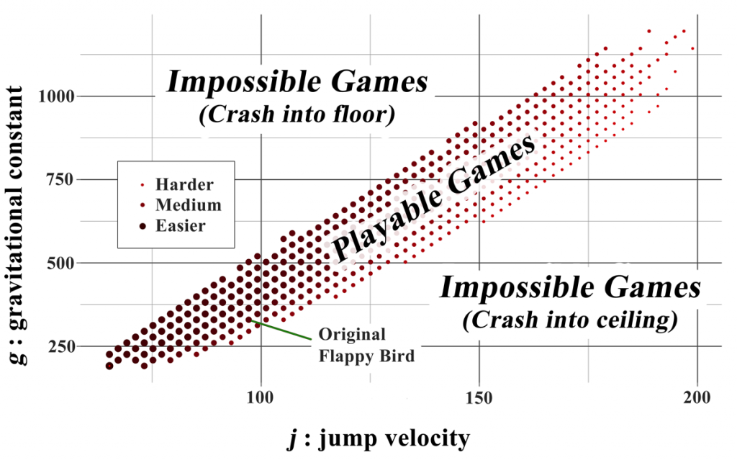
Searching the game space
After searching for playable games and clustering them
Different clusters led to games with a significantly different feel, even though the rules were the same
See link for more info

Slide 29
Comments on Isaksen’s Work
Excellent example of doing interesting work with simple AI
Uses games for which the development of an optimal or near-optimal AI is possible (perhaps even easy)
Then adds noise to the actions of the AI bots to simulate weaker play and human error
Noise can be added to vary the time
Can define the standard deviation of the added noise
Very cool!!!

Slide 30
Constructing a Searchable Game Design Space Approach: Identify Characteristic Dimensions of a Game Genre e.g. 2-D Arcade Games

Slide 31
Approach: Identify Characteristic Dimensions of a Game Genre e.g. 2-D Arcade Games
Game rules
Object types
Vehicle physics
Input controls
Weapon systems
Game views
Level designs
AI Behaviour

Slide 32
Game Rules
What happens when things collide? (define in Collision Matrix)
Reward structure (points, lives/health/ammo gained and lost)
Game state transition structure (e.g. when is a level cleared?)
These are fundamental to the nature of the game
Small changes can radically alter the game
For example, flipping the sign on a reward signal

Slide 33
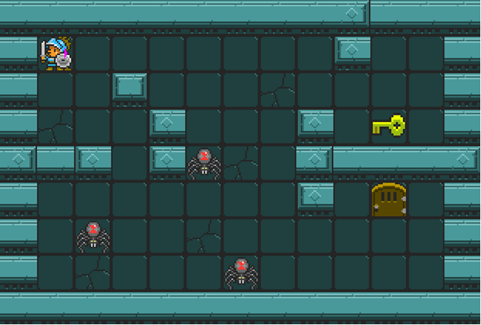
Object Types
Things to:
Shoot
Collect
For reward
Or power up / health
Jump on
Protect
Infect
Bounce off

Slide 34

Vehicle Physics
How do actions affect the movement of the vehicle (space ship)
Left-right?
Car-like?
Asteroids-style space ship
Thrust forward / reverse
Thrust always on? (this is an interesting twist)

Slide 35
Input Controls
Related to vehicle physics but distinct
How is the ship / game controlled
E.g. Classic arcade versus one tap or one touch (let’s say with one-touch the duration of touch counts too, as well as the timing of the touch)
Can also vary the input mode completely
E.g. Tap-based Pac-Man where each tap gives Pac-Man an aim-point

Slide 36
Weapon Systems
Things to vary include:
Firing rate (and cannon cool down)
Missile velocity profile
How fast does it travel
And does it slow down (like a bullet) or speed up (like a rocket)
Missile range
Missile steer
(make ship movement steer the missile – like Galaxians)

Slide 37
Game Views
Fixed versus panning / scrolling / zooming viewport)
2D versus 3D, fully versus partially observable
Note that this can radically alter the nature and difficulty of a game
In game theory terms may also be significant e.g.
Transform a game of perfect information into a partially observable one (and an MDP into a POMDP)
What about Lights-Out Space Battle
Play without seeing anything – except the score!
Actually an already studied game: Kriegspiel

Slide 38
Level Design
This obviously has a significant impact on the difficulty and interest of a game
Ms Pac-Man is a classic example
Where levels differ in maze layouts
And also in the parameters (edible time, speed of Ms Pac-Man and speed of Ghosts)
For Asteroids exercise focus on speed, size and movement (and possibly nature) of the Asteroids

Slide 39
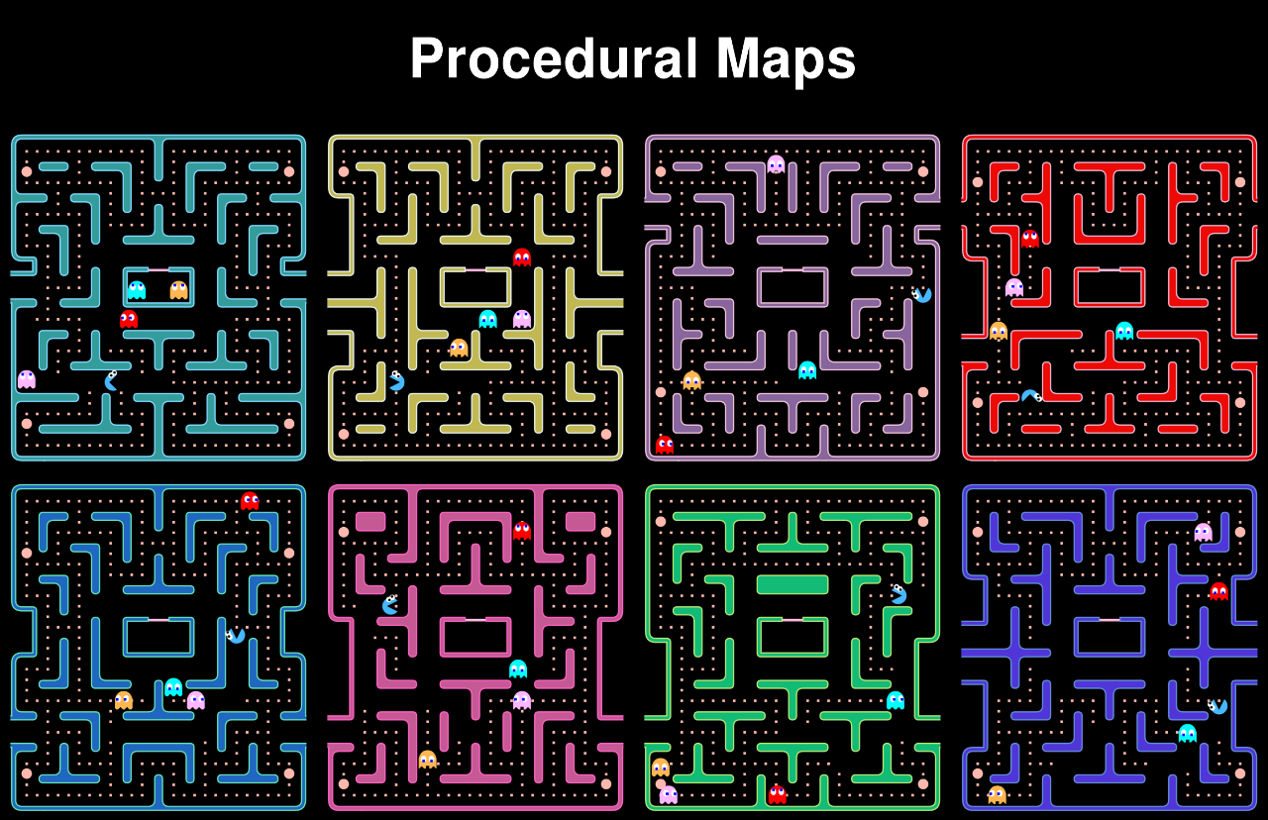
Ms Pac-Man Example

Slide 40
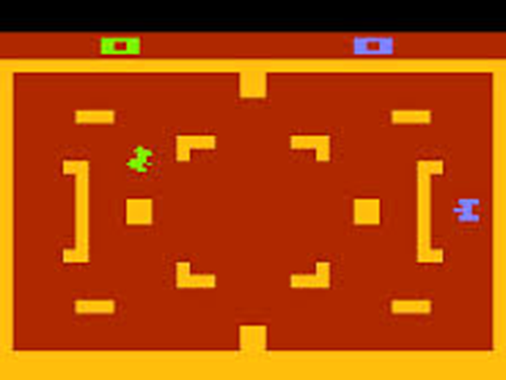
AI Behaviour
This can be a big and complex one
But we’ll experiment with powerful AI on this course
To help manage the complexity
Good AI can make for a very engaging experience – for even a simple battle game
E.g. Atari Tank Battle was brilliant – to play against a human opponent (in this case HI instead of AI)

Slide 41
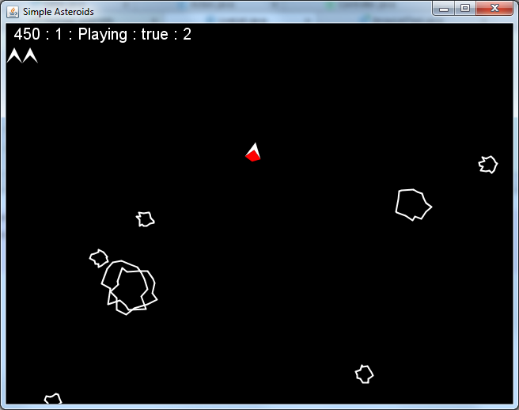
Asteroids Toolkit

Slide 42
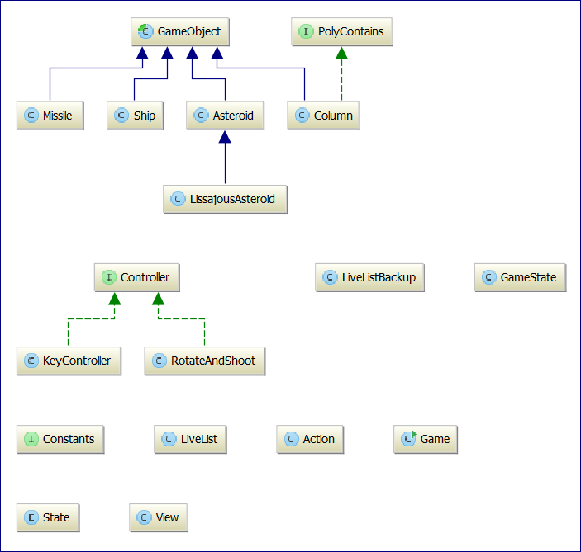
Asteroids Derived Toolkit
Bit messy
But can be run very fast
Includes
Basic Asteroids Game
“Flappy Bird” style columns

Slide 43
Lab Exercises
Download and extract the file SimpleAsteroids.zip from the course area
Then attempt the exercises on the following slides
The aim is to gain experience with various aspects of the code to vary the design of the game

Slide 44
Parameter Tuning
Spend some time studying the code, then attempt the following and observe the effects
Vary the Ship friction (lossFactor)
What happens if you set lossFactor slightly larger than 1.0? (e.g. 1.01)
Experiment with having the ship’s thrust locked on or normal
Vary the missile firing (velocity, firing rate, range, …)

Slide 45
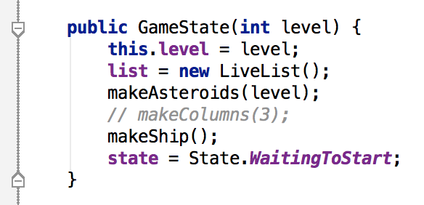
Flappy Ship
Add a FlappyBird style ship to the code
To do this, refactor->copy the code for Ship, then rewrite to modify the update code
When the Ship is made, make an instance of FlappyShip instead of the normal one
Then switch to adding columns instead of adding Asteroids (uncomment the makeColumns method in the GameState constructor … )

Slide 46
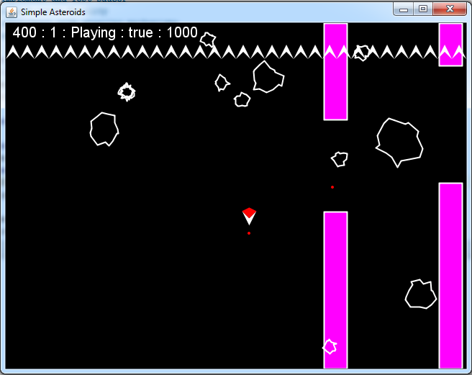
Flappy Asteroids
Now have to pass through the pipes as well as surviving the Asteroid Shower!
Very bad news for Rotate-n-Shoot!

Slide 47
Two-Faced Asteroids Exercise
One side explodes the Asteroid as normal
The other causes the missile to bounce straight back
Also very bad news for Rotate-n-Shoot!!
(We’ll release a solution to this later in case you get stuck)

Slide 48
Two-Face Exercise Tips
Create a sub-class of Asteroid that has two polygons (and draw one as red and one as green)
When it is hit (using the simple default radius proximity test, test which polygon was hit)
If green, process as a normal hit
Else if red, launch a missile that is aimed directly at the ship
To see how to launch a missile, refer to the Ship class

Slide 49
Optional Landing Pad Exercise
Add a new Game Object called a Landing Pad
Landing on a Pad at low velocity should produce a reward. Too high and the ship dies
Experiment with moveable landing pads
Try mixing LandingPads with other game features
E.g. a dangerous Asteroid Belt that can be destroyed in order to make for an easier landing

Slide 50
Group Exercise
Identify a number of features of Asteroids and other similar games to create an implementable Design Space for Asteroids.
It should be possible to create new variants of the game by picking random parameter values
Pick what you expect to be an interesting design space and try to implement it

Slide 51
Deliverables of Group Exercise
Data bound Class (i.e. a class whose main purpose is to hold data items) defining the game space
Each field can be used for a primitive type or an object type
Use of object types can help to structure the design space
For example, can separate out aspects of ship control from aspects of Asteroid design

